Slide 1


pwsh?
This might not be the session you are looking for
!= !=
Using PowerShell on Linux
Rob Sewell - Sewells Consulting Ltd

Slide 4

Rob Sewell
Bearded Consultant, Automator,
Trainer
Consultant Sewells Consulting Ltd
beard.media/book dbachecks PowerShell & Data Community
/robsewellsqldba
@sqldbawithbeard
SQLDBAWithABeard.com

Slide 5

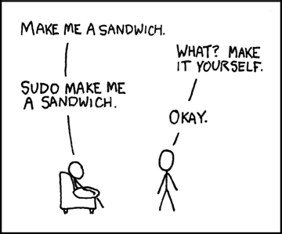
Notes:
PS Core 6.1 released Sept 2018 ; .NET Core version up to 2.1 which is LTS releasePS Core 6.2 GA March 2019
Focused on Performance
Background Jobs - 1..5 | %{Start-Job {Get-Process} ; Get-Job ; Wait-job}
5.1 no threadjobs 1minute 30
6 Regular background jobs twice as fast
Threadjobs 300 milliseconds
Enable-ExperimentalFeature
Temp:/ drive7 Bundled in Windows some day..Net Core 3Backward Compatibility

Slide 6
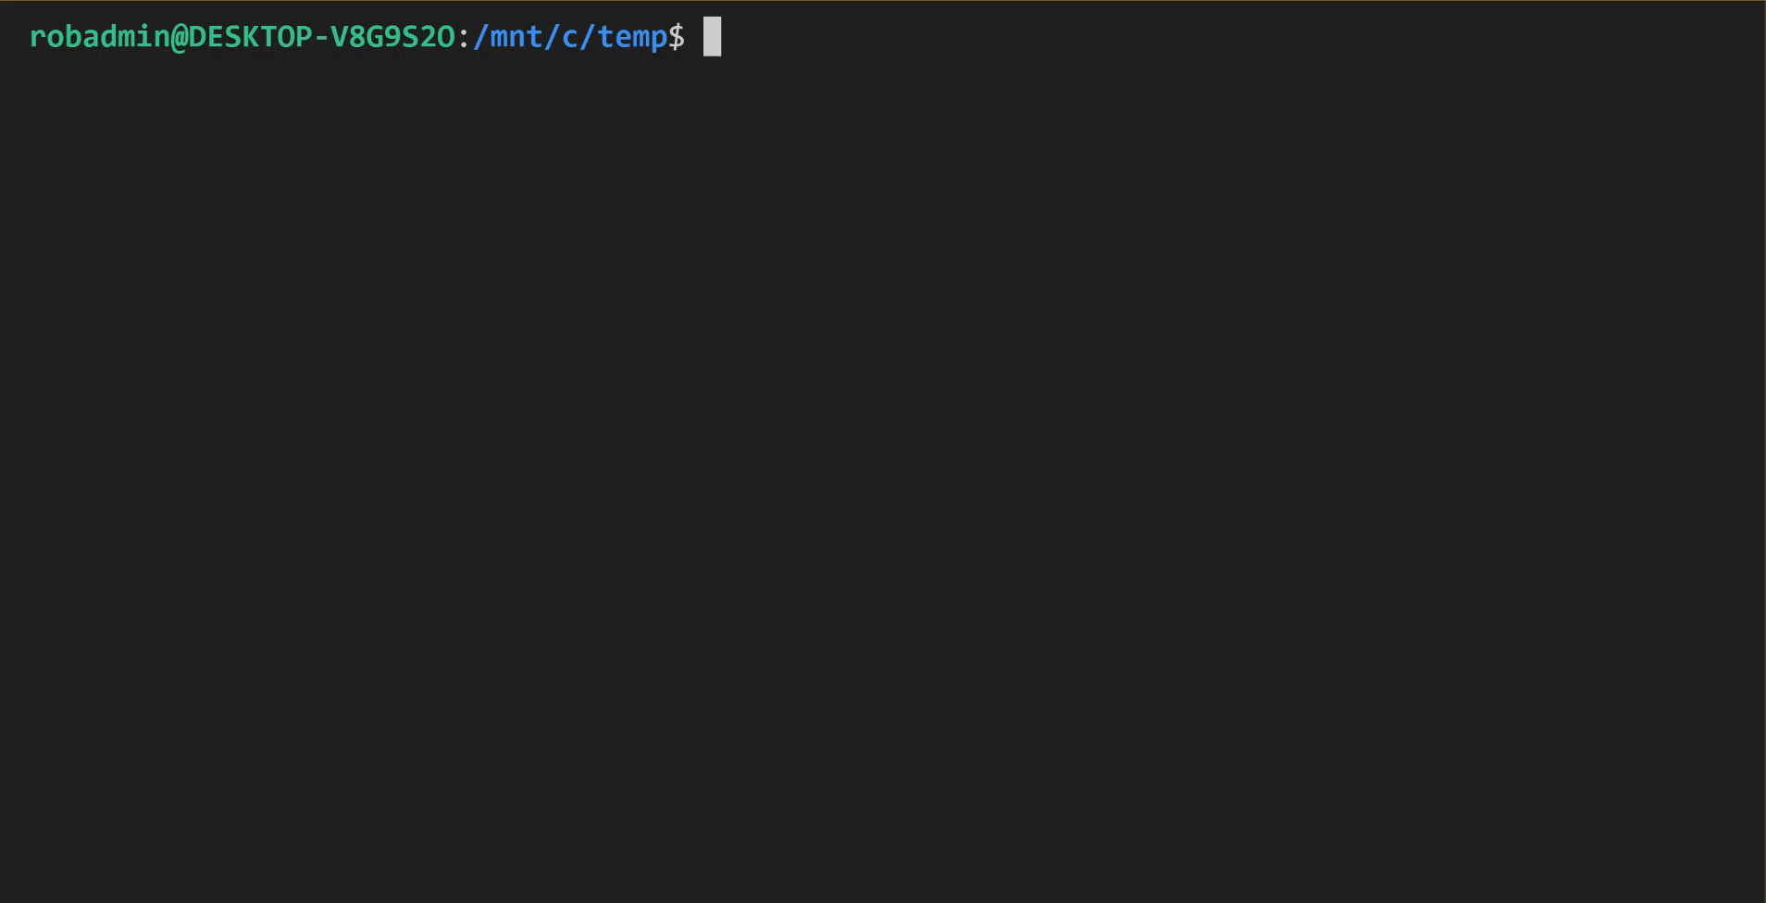

Slide 7

PowerShell Release History Not from the Monad Manifesto in 2002!
PowerShell 1.0 – November 2006
PowerShell 2.0 – October 2009
PowerShell 3.0 – September 2012
PowerShell 4.0 – October 2013
PowerShell 5.0 – February 2016
Windows PowerShell 5.1 – January 2017
Notes:
PS Core 6.1 released Sept 2018 ; .NET Core version up to 2.1 which is LTS releasePS Core 6.2 GA March 2019
Focused on Performance
Background Jobs - 1..5 | %{Start-Job {Get-Process} ; Get-Job ; Wait-job}
5.1 no threadjobs 1minute 30
6 Regular background jobs twice as fast
Threadjobs 300 milliseconds
Enable-ExperimentalFeature
Temp:/ drive7 Bundled in Windows some day..Net Core 3Backward Compatibility

Slide 8

PowerShell Release History Not from the Monad Manifesto in 2002!
PowerShell Core 6.0 – January 2018
PowerShell Core 6.1 – September 2018
PowerShell Core 6.2 – March 2019
PowerShell Core 7 – GA TBA
Notes:
PS Core 6.1 released Sept 2018 ; .NET Core version up to 2.1 which is LTS releasePS Core 6.2 GA March 2019
Focused on Performance
Background Jobs - 1..5 | %{Start-Job {Get-Process} ; Get-Job ; Wait-job}
5.1 no threadjobs 1minute 30
6 Regular background jobs twice as fast
Threadjobs 300 milliseconds
Enable-ExperimentalFeature
Temp:/ drive7 Bundled in Windows some day..Net Core 3Backward Compatibility

Slide 9

A smaller, open source re-implementation of the .NET framework.
.NET Core covers a broad set of functionality that uses the native API's of the platform it's running on.
Notes:
This allowed the PowerShell team to port most of the PowerShell engine over and gain the ability to run PowerShell on multiple platforms, without changing much of the surface API you use.

Slide 10
pwsh.exe
Notes:
This means there are now two products: Windows PowerShell and PowerShell Core.
Windows PowerShell will be pinned at 5.1, and only have security or major bugfixes released.
All new features and new work will be devoted to PowerShell Core.
Can't use POSH because it's an actively maintained linux project https://www.commandlinux.com/man-page/man1/posh.1.html A bourne shell re-implementation
https://github.com/PowerShell/PowerShell/issues/4214

Slide 11
Why Use PowerShell?
Shell and scripting language
Cross-platform Multi Operating System Multi Cloud Containers

Slide 12

Just Like Your Estate
Photo by İrfan Simsar on Unsplash

Slide 13
Why not use other languages?
Look – They are awesome I’m not saying that they are not
Generally not designed for Windows
Generally difficult to install on Windows (or configure OS to run)
Generally running cross platform code on Windows doesn’t work as expected

Slide 14

YMMV
Photo by Mahkeo on Unsplash

Slide 15
What is pwsh good for?
Interacting with Web Services
Data Conversion and Manipulation
CICD/Build/Deployment Scripts
Pester
Notes:
Mark Kraus
Data conversion from JSON for example powershell objects

Slide 16
Maybe not so good for
Deep System Integration
Displaying Interfaces
Colorized Output From Binaries
Notes:
Reaching into the operating system as designed to work with APIs

Slide 17

Install-PowerShell
Photo by Vincent Botta on Unsplash

Slide 18
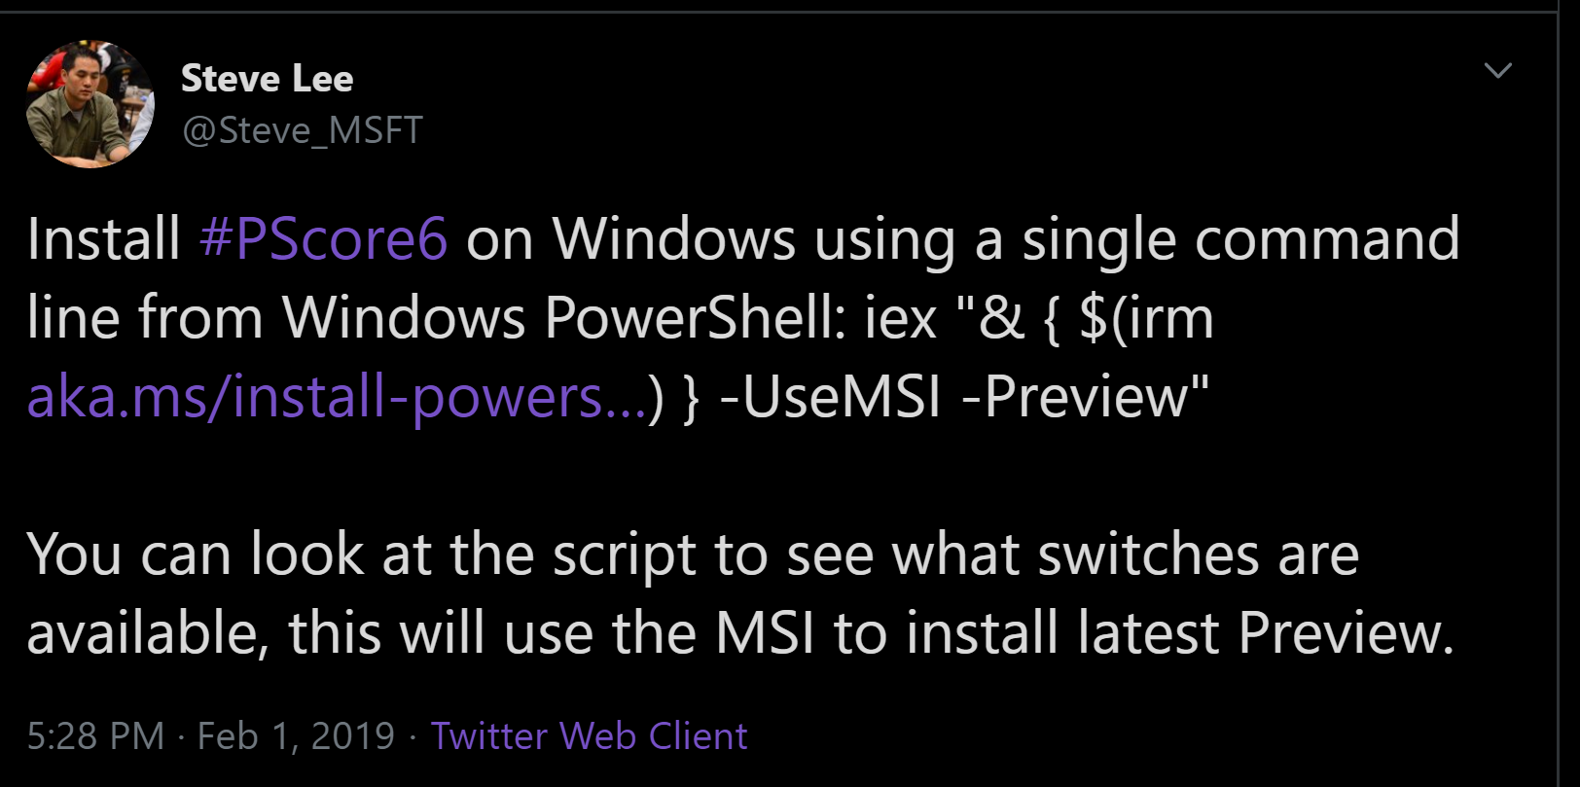
Fits in a Tweet!
wget -O - https://aka.ms/install-powershell.sh | sudo bash

Slide 19
Install – More Seriously!
macOS
brew cask install powershell
Linux
sudo apt-get install -y powershell
sudo yum install -y powershell
sudo dnf install -y powershell
Windows
choco install powershell-core -y

Slide 20
https://aka.ms/pscore6
Notes:
I took some liberties with the last slide, there are a few other bits to do

Slide 21

Photo by Clem Onojeghuo on Unsplash

Slide 22
You Only Need 4 Things
Get-Command *search*
Get-Help NAMEOFCOMMAND
$exploring = run the command
$exploring | Get-Member
Notes:
Reaching into the operating system as designed to work with APIs

Slide 23
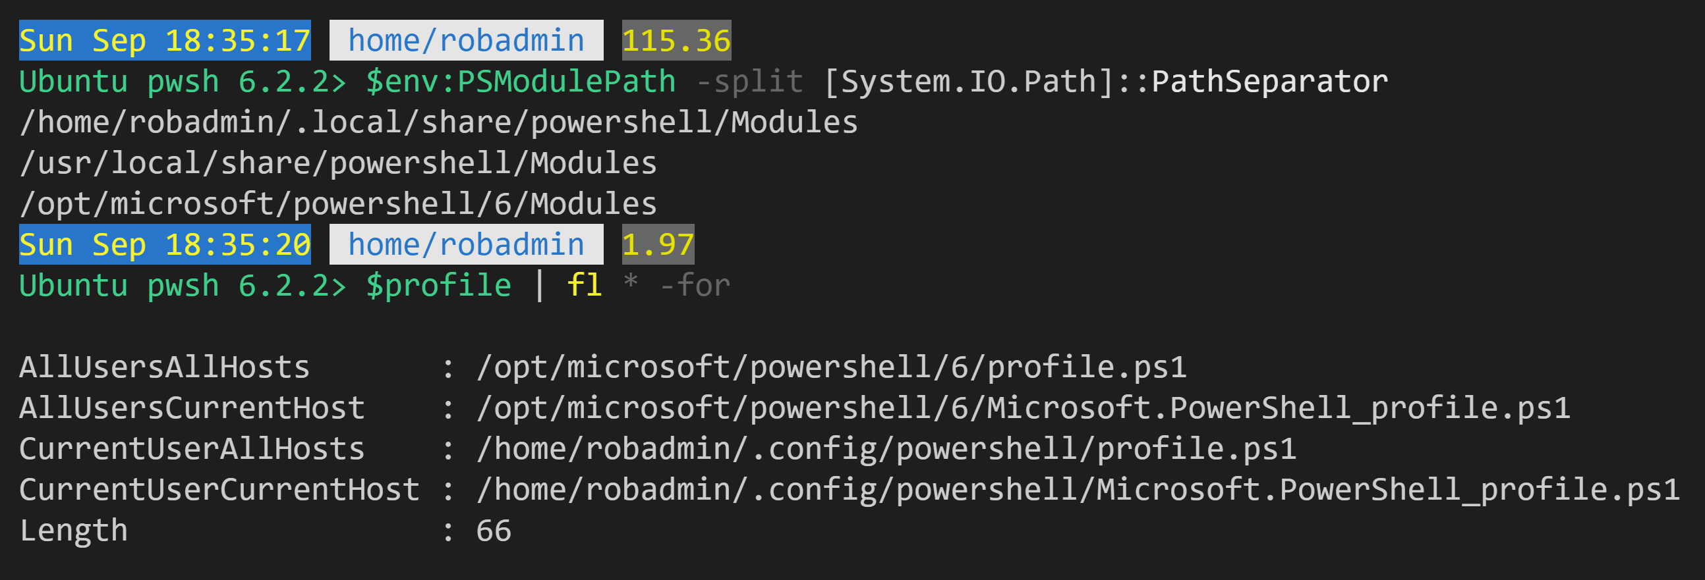
Where do things go ?

Slide 24
pwsh as your default shell

Slide 25
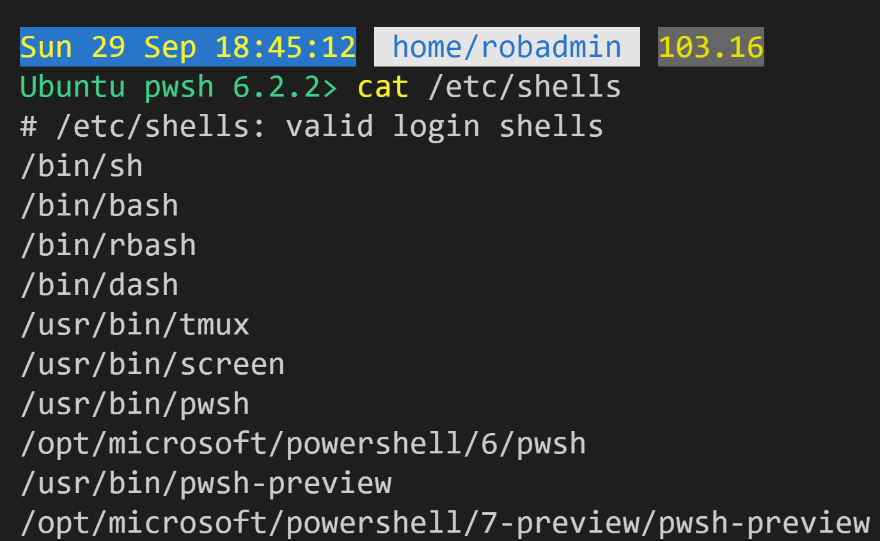
Identify available shells
cat /etc/shells

Slide 26
Identify available shells
Executable

Slide 27
Identify available shells
Sym Link

Slide 28
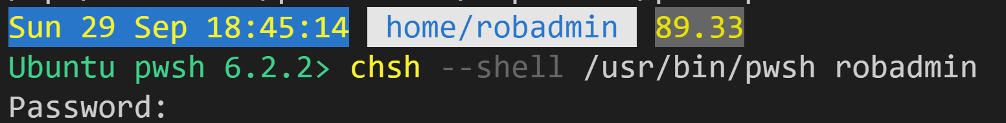
Set Default Shell for user

Slide 29
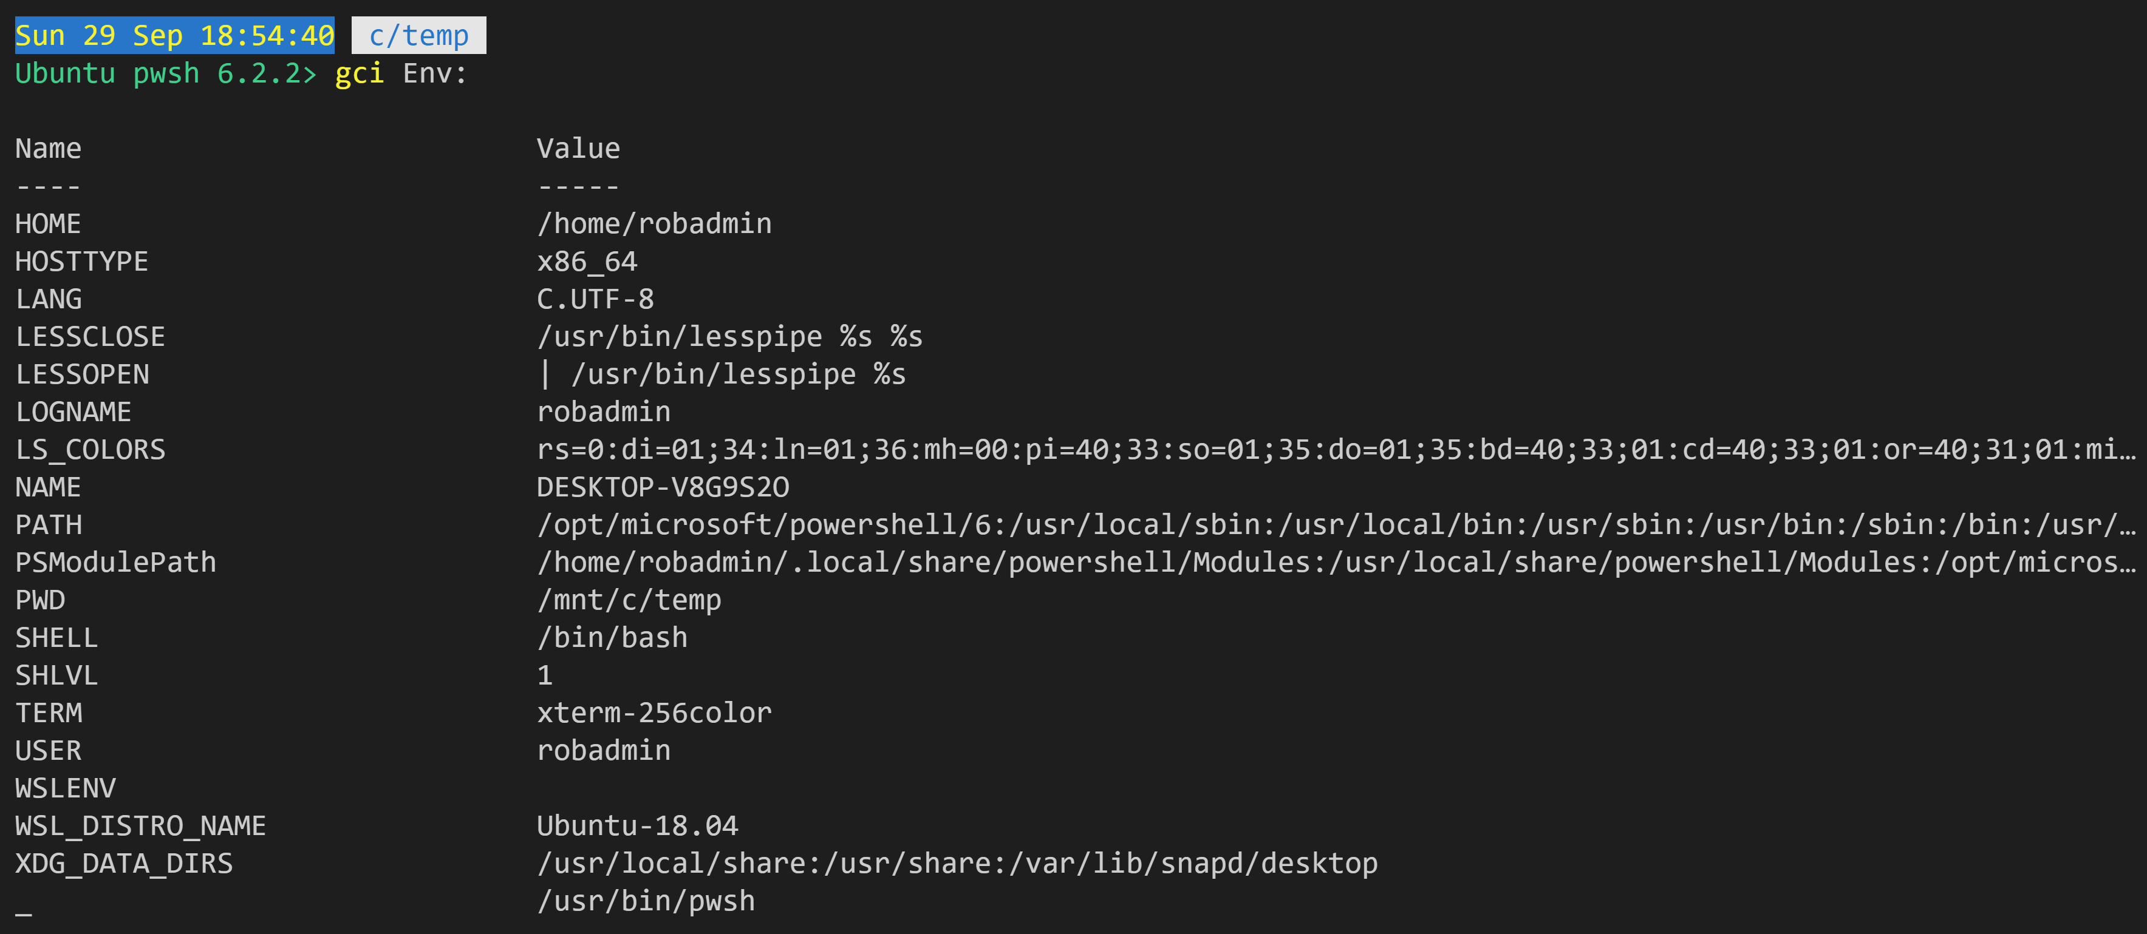
Look Out
Environment Variables on Linux are case sensitive, just like the file system.
So they use ALLCAPS

Slide 30
Look Out
except for $env:PSModulePath !!

Slide 31

Import-Module is a special snowflake
Photo by Darius Cotoi on Unsplash

Slide 32
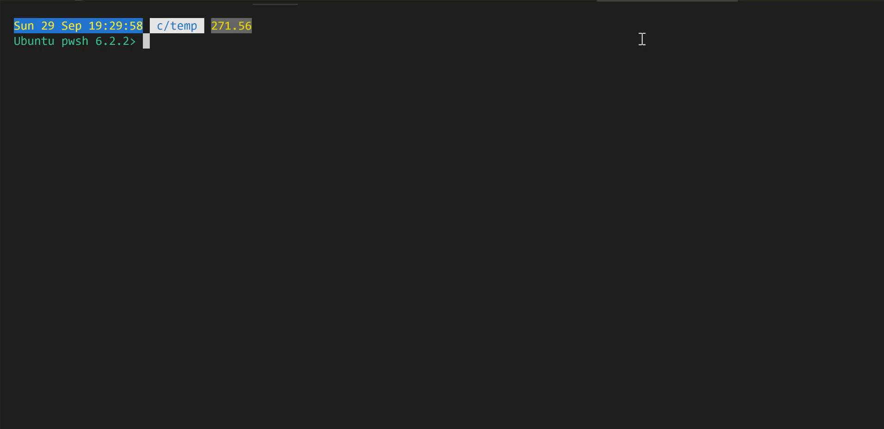
Photo by Darius Cotoi on Unsplash

Slide 33

Identify your platform
$IsLinux $IsMacOS $IsWindows $IsCoreCLR
Photo by Glen . on Unsplash

Slide 34
$IsLinux $IsMacOS $IsWindows $IsCoreCLR
Regular variables like these are not case sensitive.
Photo by Glen . on Unsplash

Slide 35
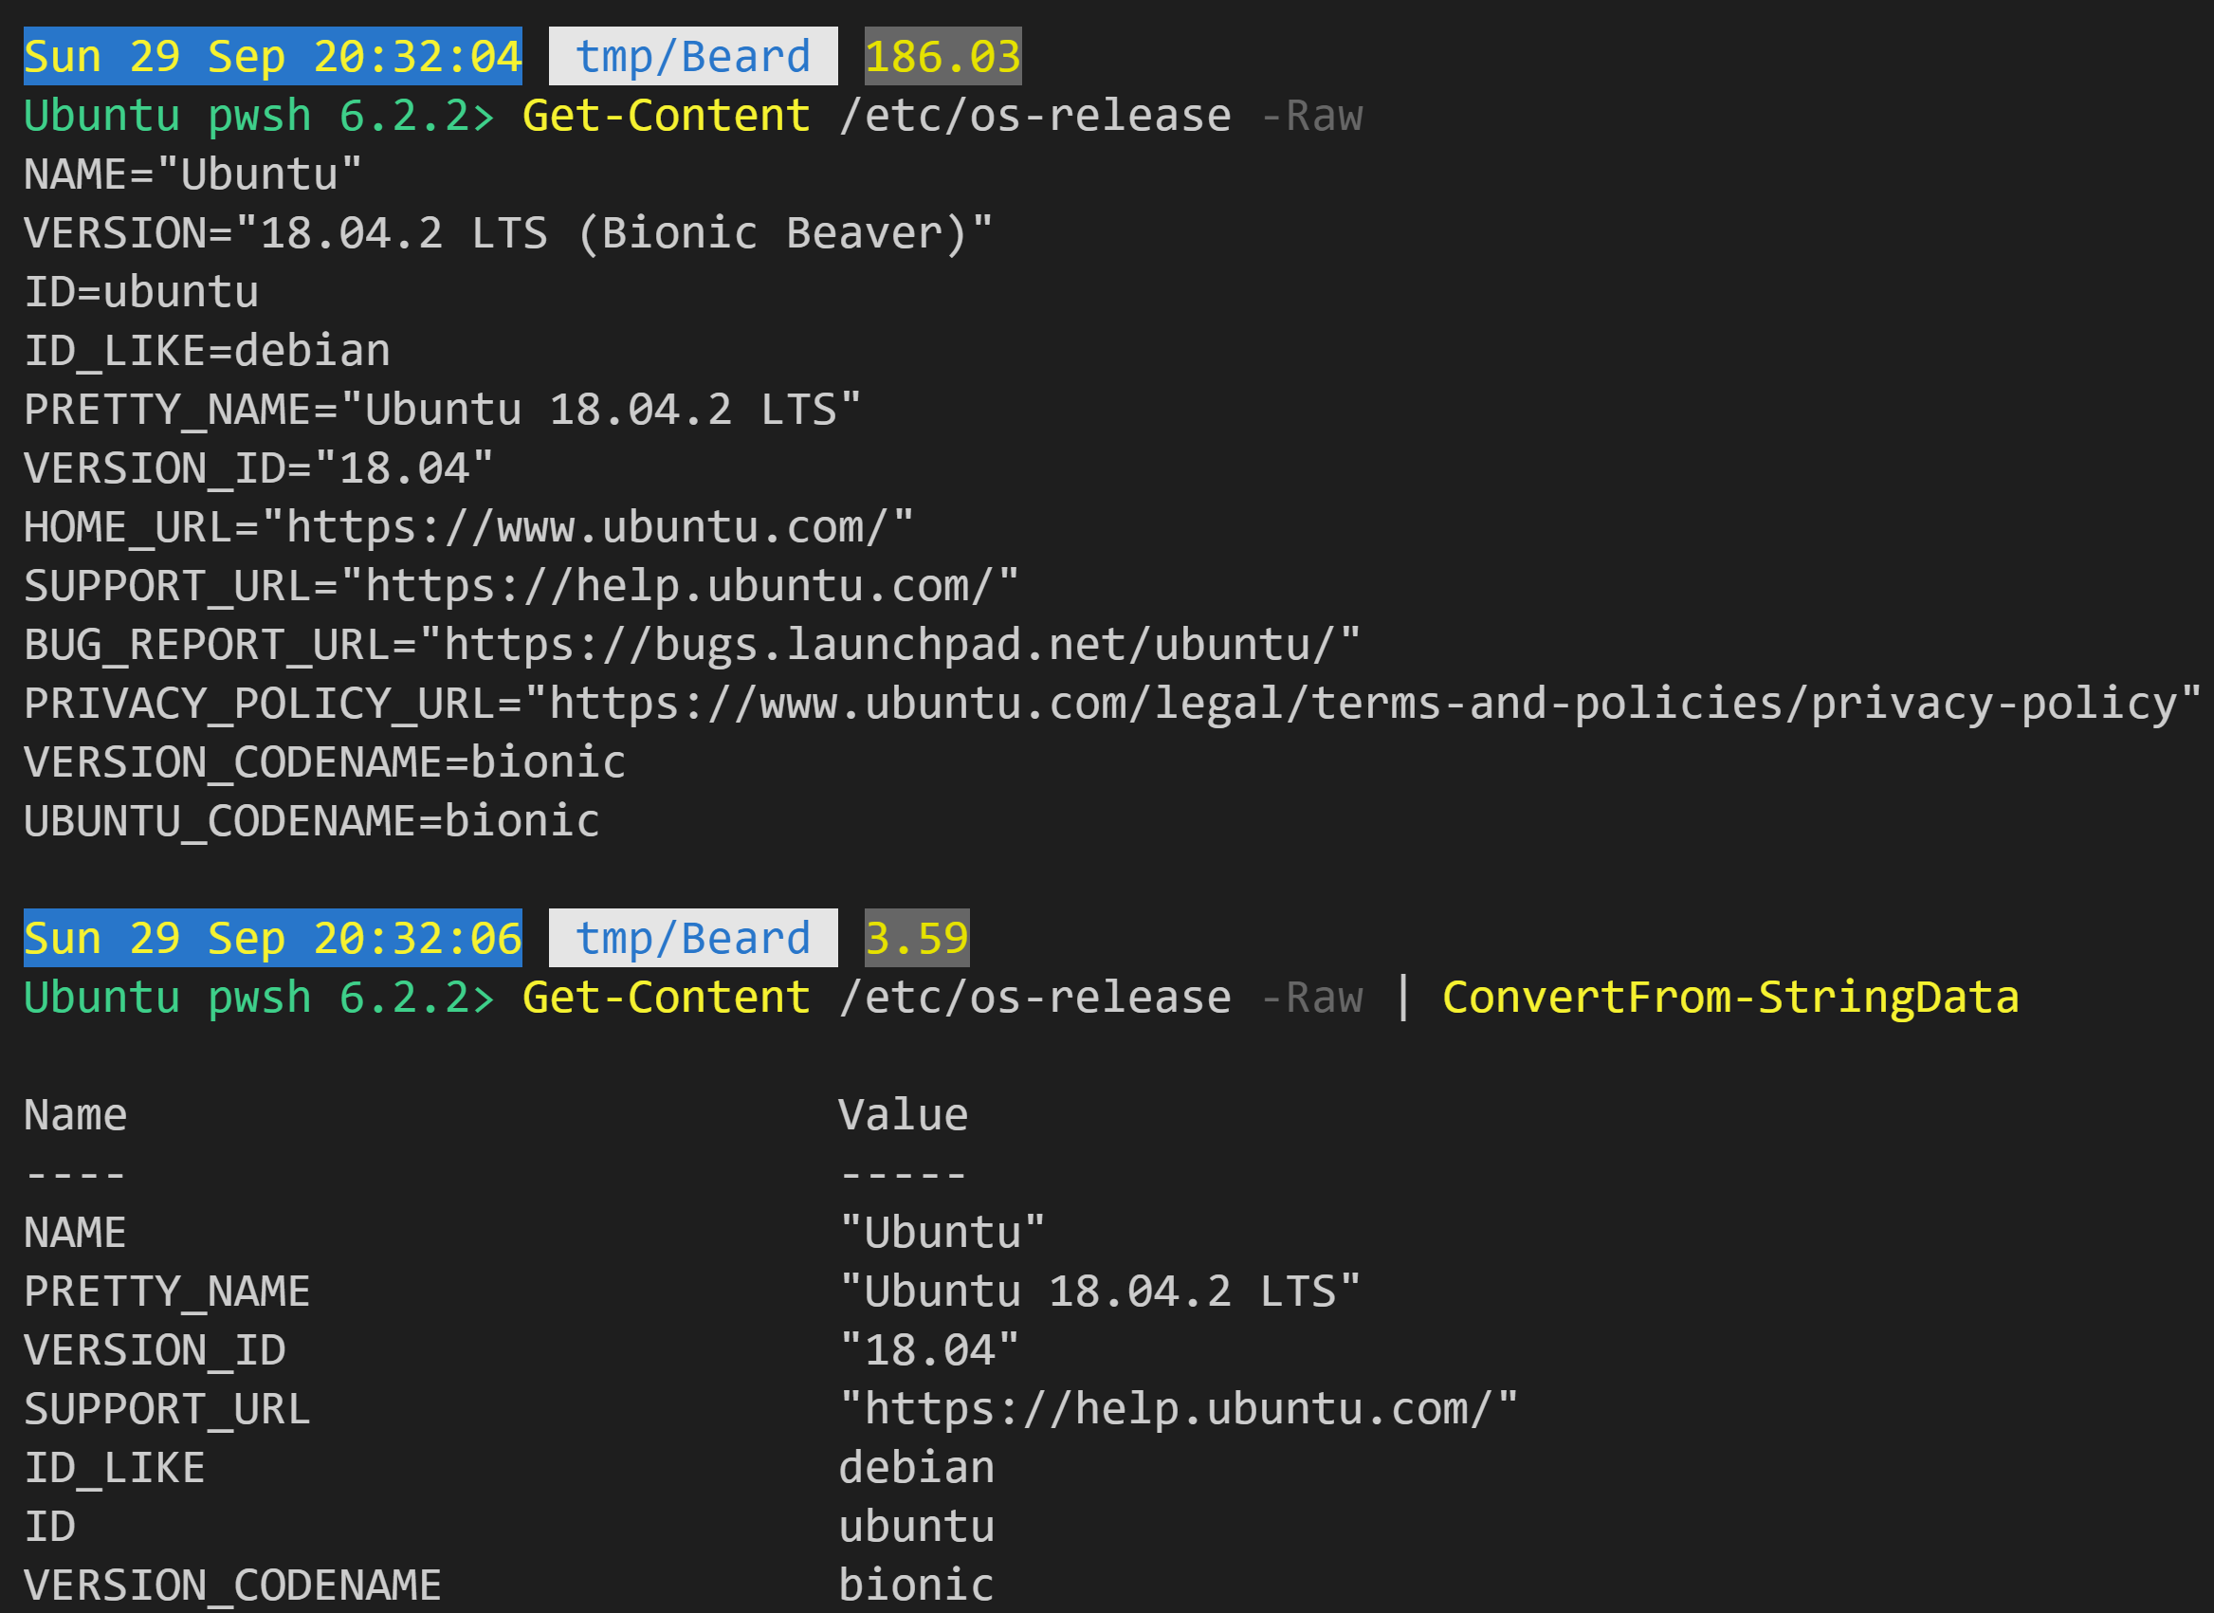
ConvertFrom-StringData enables you to read a file and return a hashtable
Get-Content /etc/os-release -Raw | ConvertFrom-StringData
Notes:
Thanks Marke Kraus - https://github.com/markekraus/PSRAW/blob/d93ca99d5bbf6ea924c3ba4f419ef394581b6e64/build.psm1#L6

Slide 36
Notes:
Thanks Marke Kraus - https://github.com/markekraus/PSRAW/blob/d93ca99d5bbf6ea924c3ba4f419ef394581b6e64/build.psm1#L6

Slide 37
File Encoding
Use UTF-8 in general
ASCII is your fallback in case of bugs.
Notes:
Look out for “old scripts” probably encoded with UTF-16
29/51
This issue is mostly solved with later tools. Can be an issue again with older scripts that were first developed in PS ISE.

Slide 38

File Encoding
Use VS Code
Identify encoding
Notes:
Look out for “old scripts” probably encoded with UTF-16
29/51
This issue is mostly solved with later tools. Can be an issue again with older scripts that were first developed in PS ISE.

Slide 39
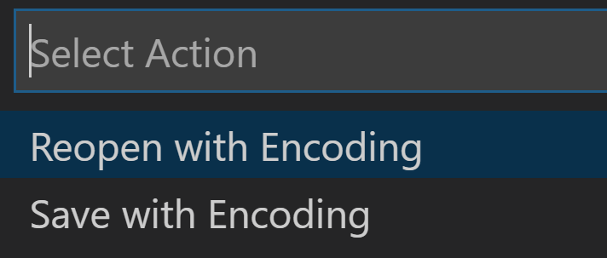
File Encoding
Use VS Code
Save or Reopen
Notes:
Look out for “old scripts” probably encoded with UTF-16
29/51
This issue is mostly solved with later tools. Can be an issue again with older scripts that were first developed in PS ISE.

Slide 40
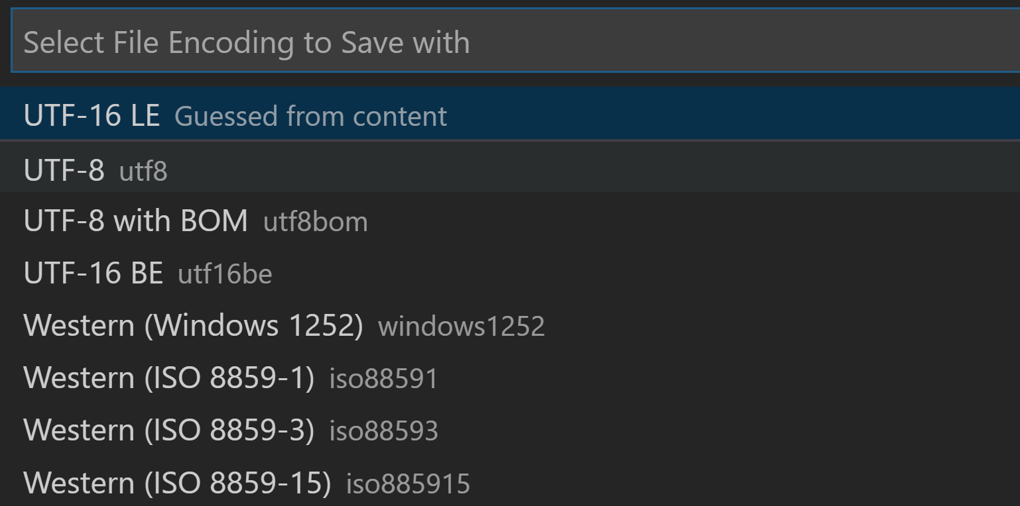
File Encoding
Use VS Code
Choose New Encoding
Notes:
Look out for “old scripts” probably encoded with UTF-16
29/51
This issue is mostly solved with later tools. Can be an issue again with older scripts that were first developed in PS ISE.

Slide 41
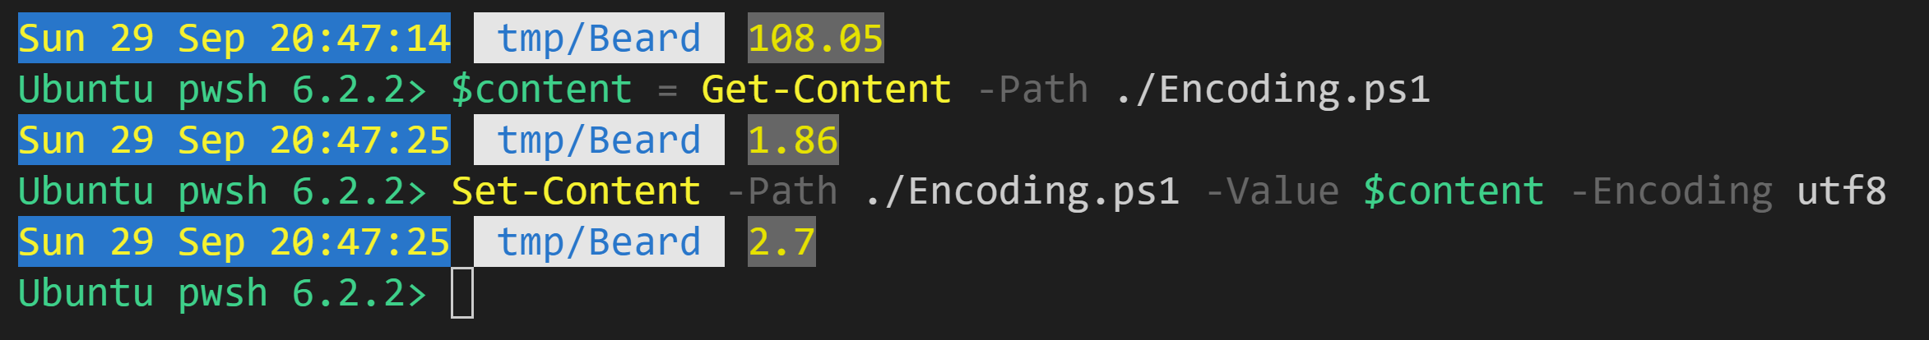
File Encoding
Use pwsh
$content = Get-Content -Path ./Encoding.ps1
Set-Content -Path ./Encoding.ps1 -Value $content -Encoding utf8
Notes:
Look out for “old scripts” probably encoded with UTF-16
29/51
This issue is mostly solved with later tools. Can be an issue again with older scripts that were first developed in PS ISE.

Slide 42
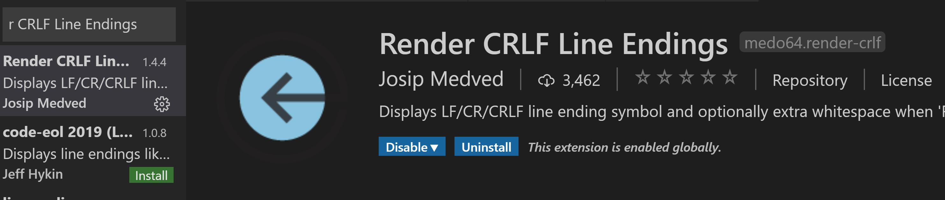
Line Endings
Most Windows apps will accept '\n'
Most Linux shell programs will fail to read '\r\n'
Install a VSCode extension to expose line endings

Slide 43
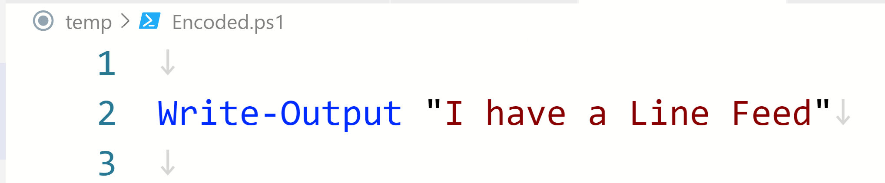
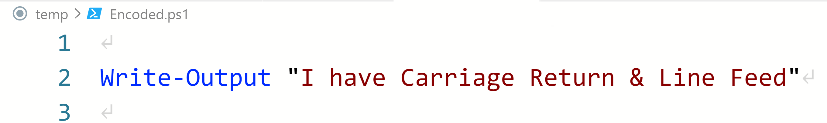
Line Endings

Slide 44
Paths
Always going to be difficult with Unix Which Slash is it?

Slide 45
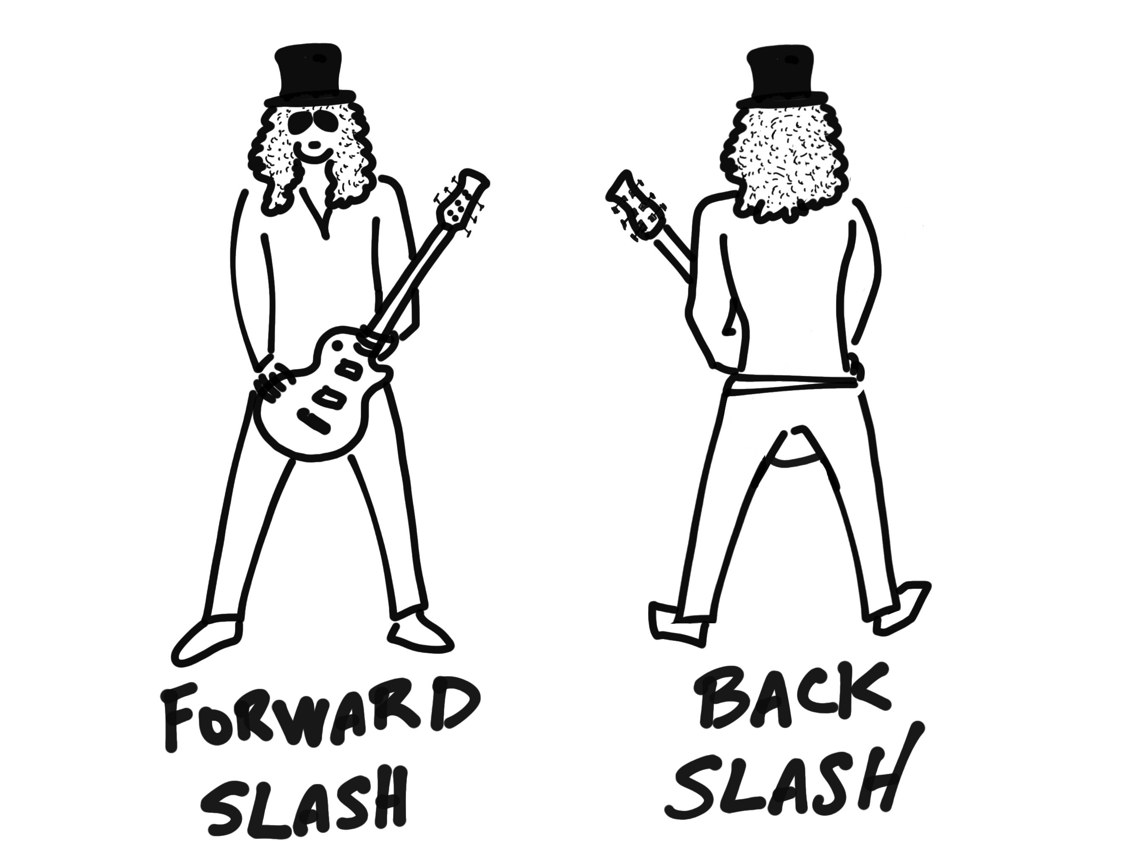
Paths

Slide 46
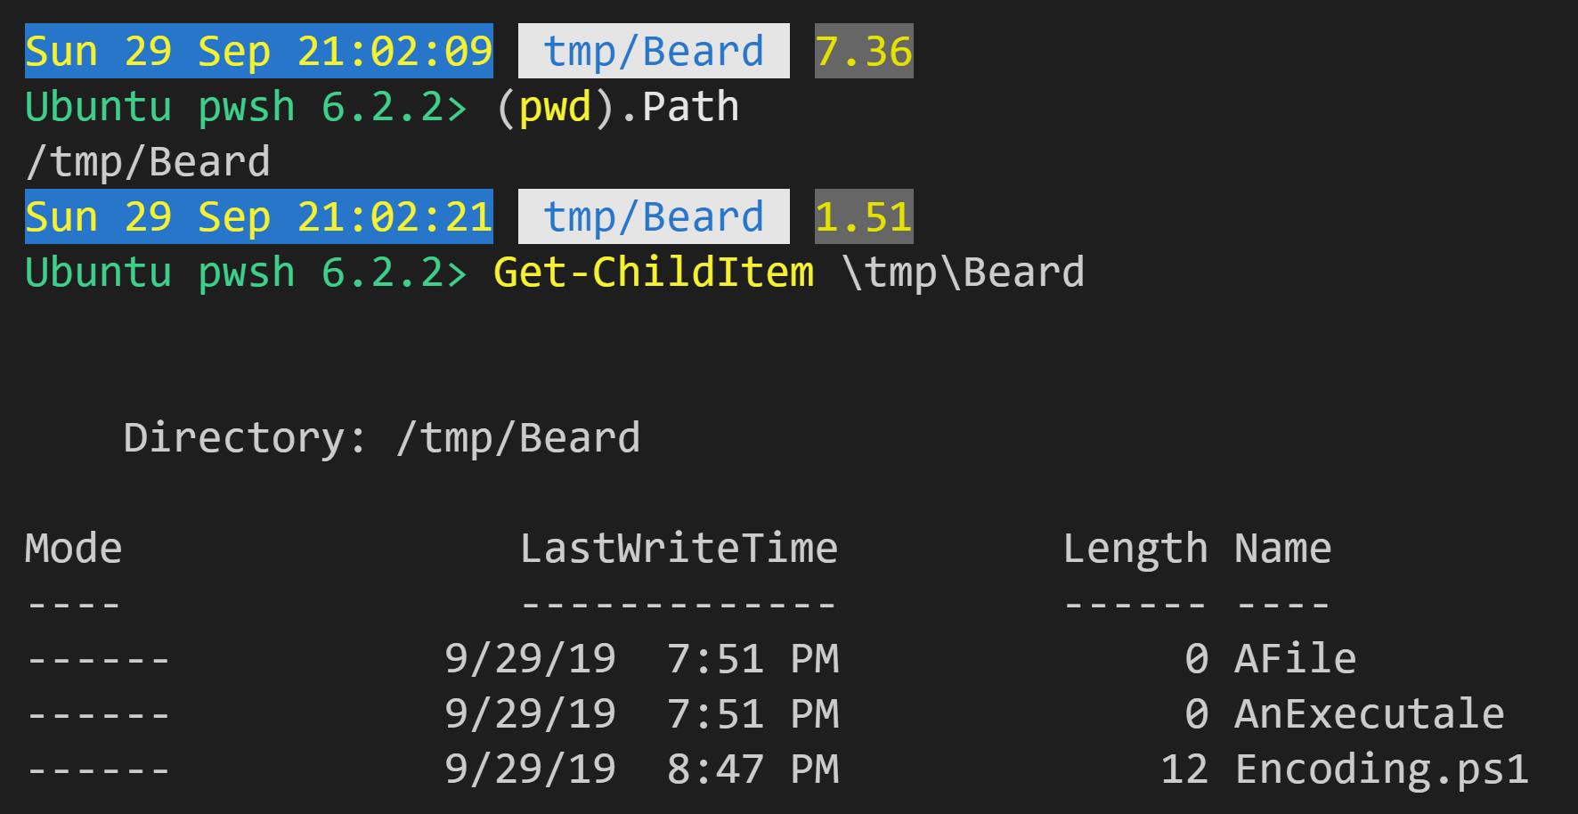
Paths
PowerShell normalizes paths even on Windows. You can use / almost everywhere.

Slide 47
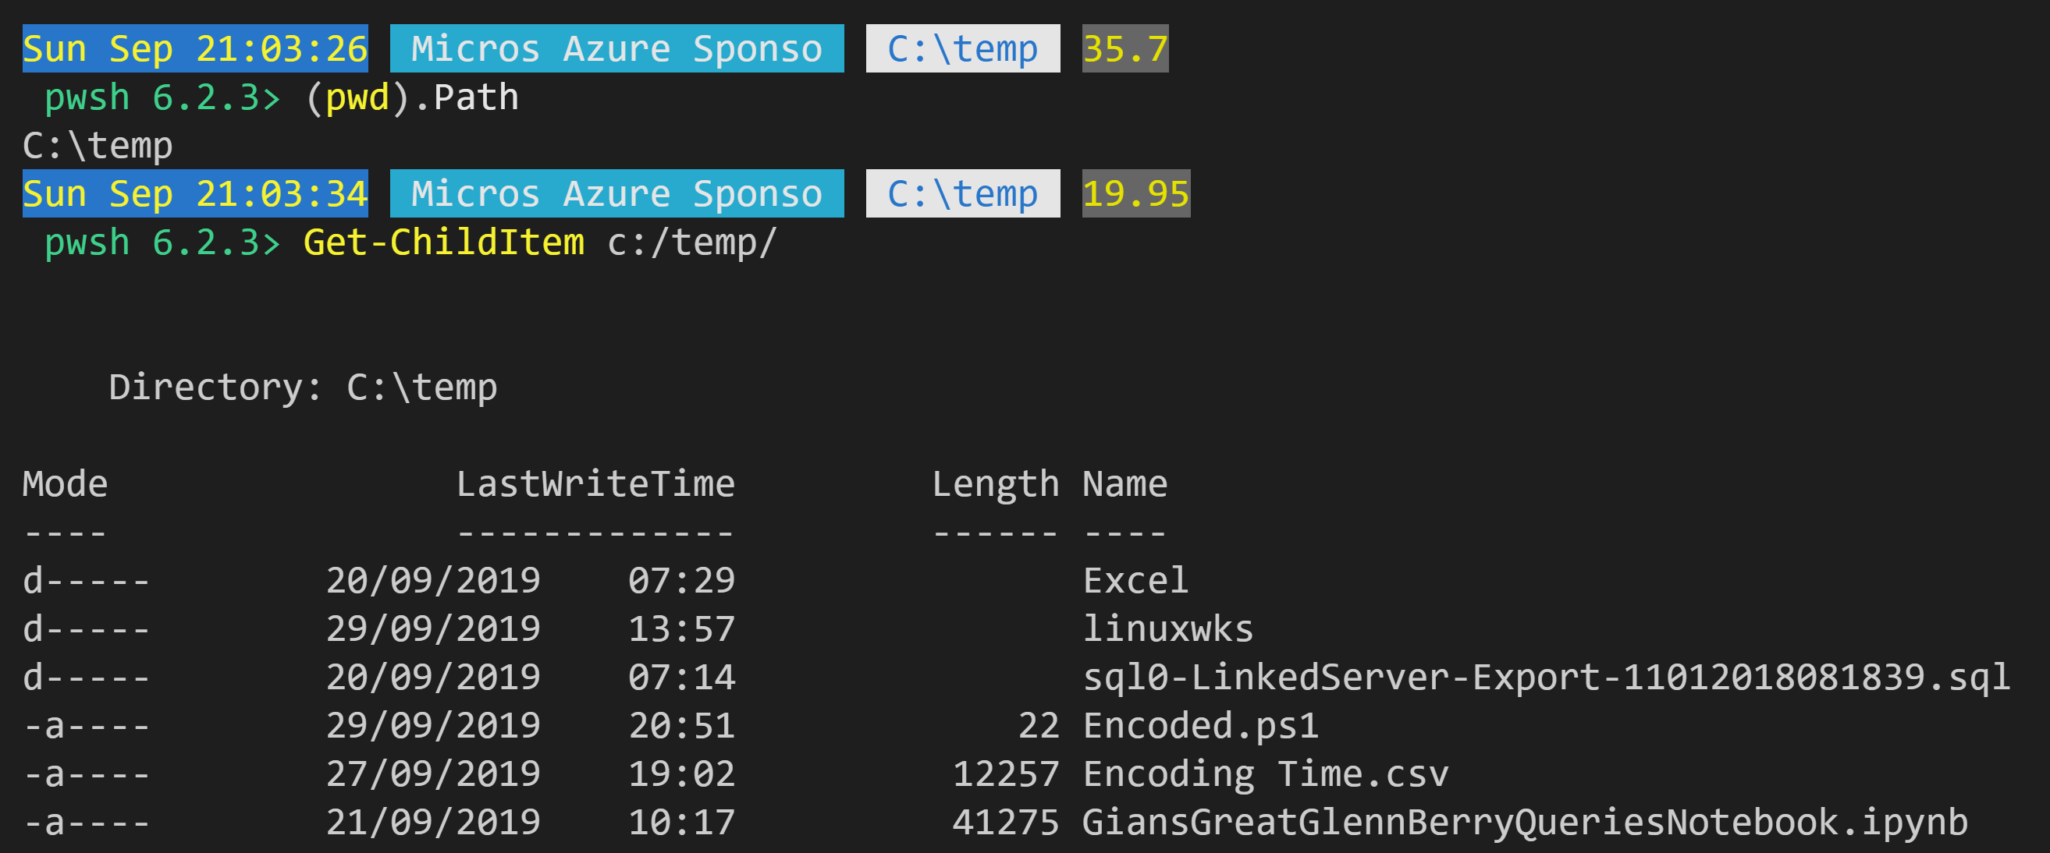
Paths
Yup I said Windows too

Slide 48

Coding
Photo by Kevin Ku on Unsplash

Slide 49
Paths - Reprise
$basepath = switch($true) {
$IsWindows { $env:TEMP }
$IsLinux {'/tmp'}
}
$joinPath = @{
Path = $basepath
ChildPath = 'sockfactory'
AdditionalChildPath = 'users','permissions'
}
Join-Path @joinpath
Don’t try to manually
construct paths
Use Join-Path

Slide 50
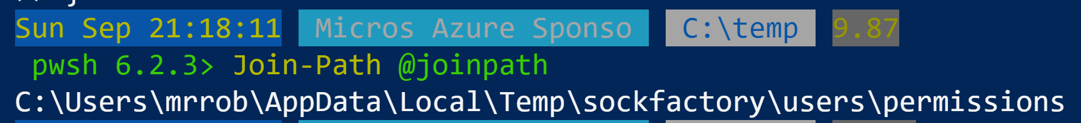
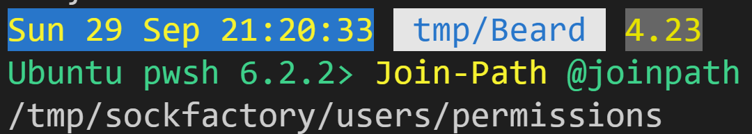
Paths - Reprise
Don’t try to manually construct paths
Use Join-Path

Slide 51

Which Editor to Use?

Slide 52
macOS
brew cask install code
Linux
sudo snap install --classic code
sudo apt-get install -y code
sudo yum install -y code
sudo dnf install -y code
https://code.visualstudio.com/docs/setup/linux

Slide 53
Validating Cross Platform Scripts
Use ScriptAnalyzer
https://github.com/PowerShell/PSScriptAnalyzer
PSScriptAnalyzer is a static code checker for Windows PowerShell modules and scripts. PSScriptAnalyzer checks the quality of Windows PowerShell code by running a set of rules.

Slide 54
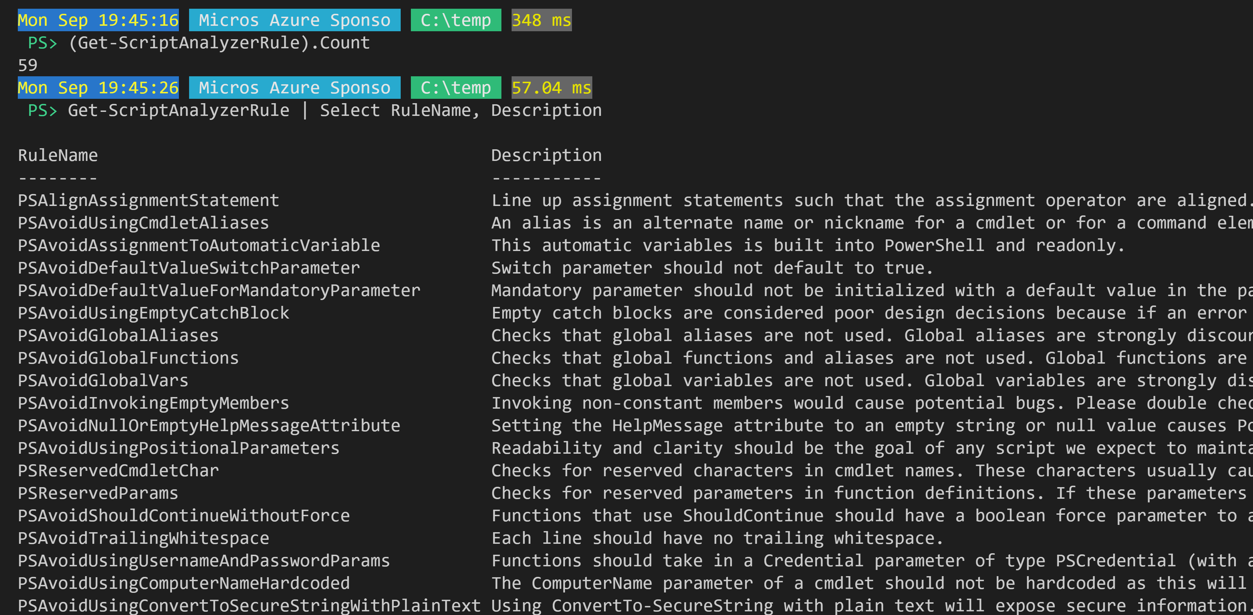
Script Analyzer Rules

Slide 55
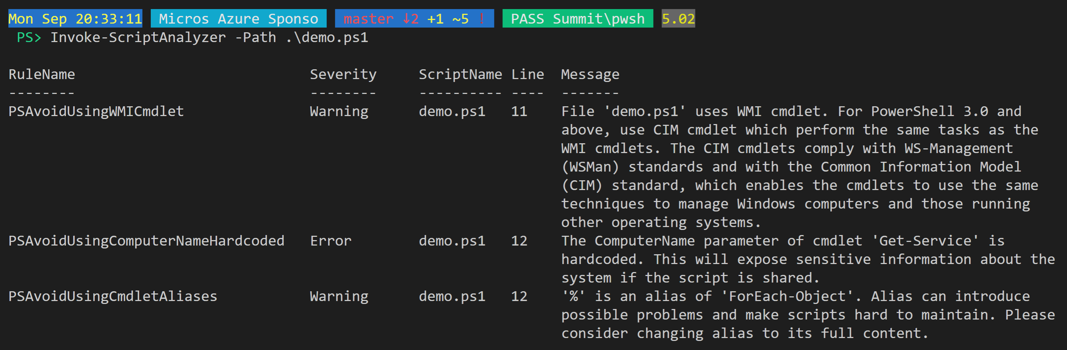
Script Analyzer
Check a script at the command line

Slide 56
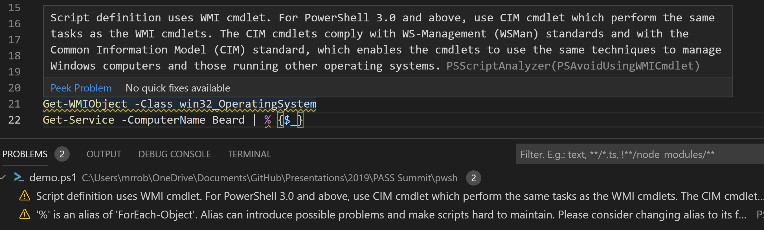
Script Analyzer in VS Code
Built in squiggly goodness

Slide 57
Script Analyzer Compatibility Checking
Compatibility checking functionality is provided by three new rules:
PSUseCompatibleSyntax, which checks whether a syntax used in a script will work in other PowerShell versions.
PSUseCompatibleCommands, which checks whether commands used in a script are available in other PowerShell environments.
PSUseCompatibleTypes, which checks whether .NET types and static methods/properties are available in other PowerShell environments.
The syntax check rule simply requires a list of PowerShell versions you want to target, and will tell you if a syntax used in your script won’t work in any of those versions.
https://github.com/PowerShell/PSScriptAnalyzer/tree/master/Engine/Settings

Slide 58
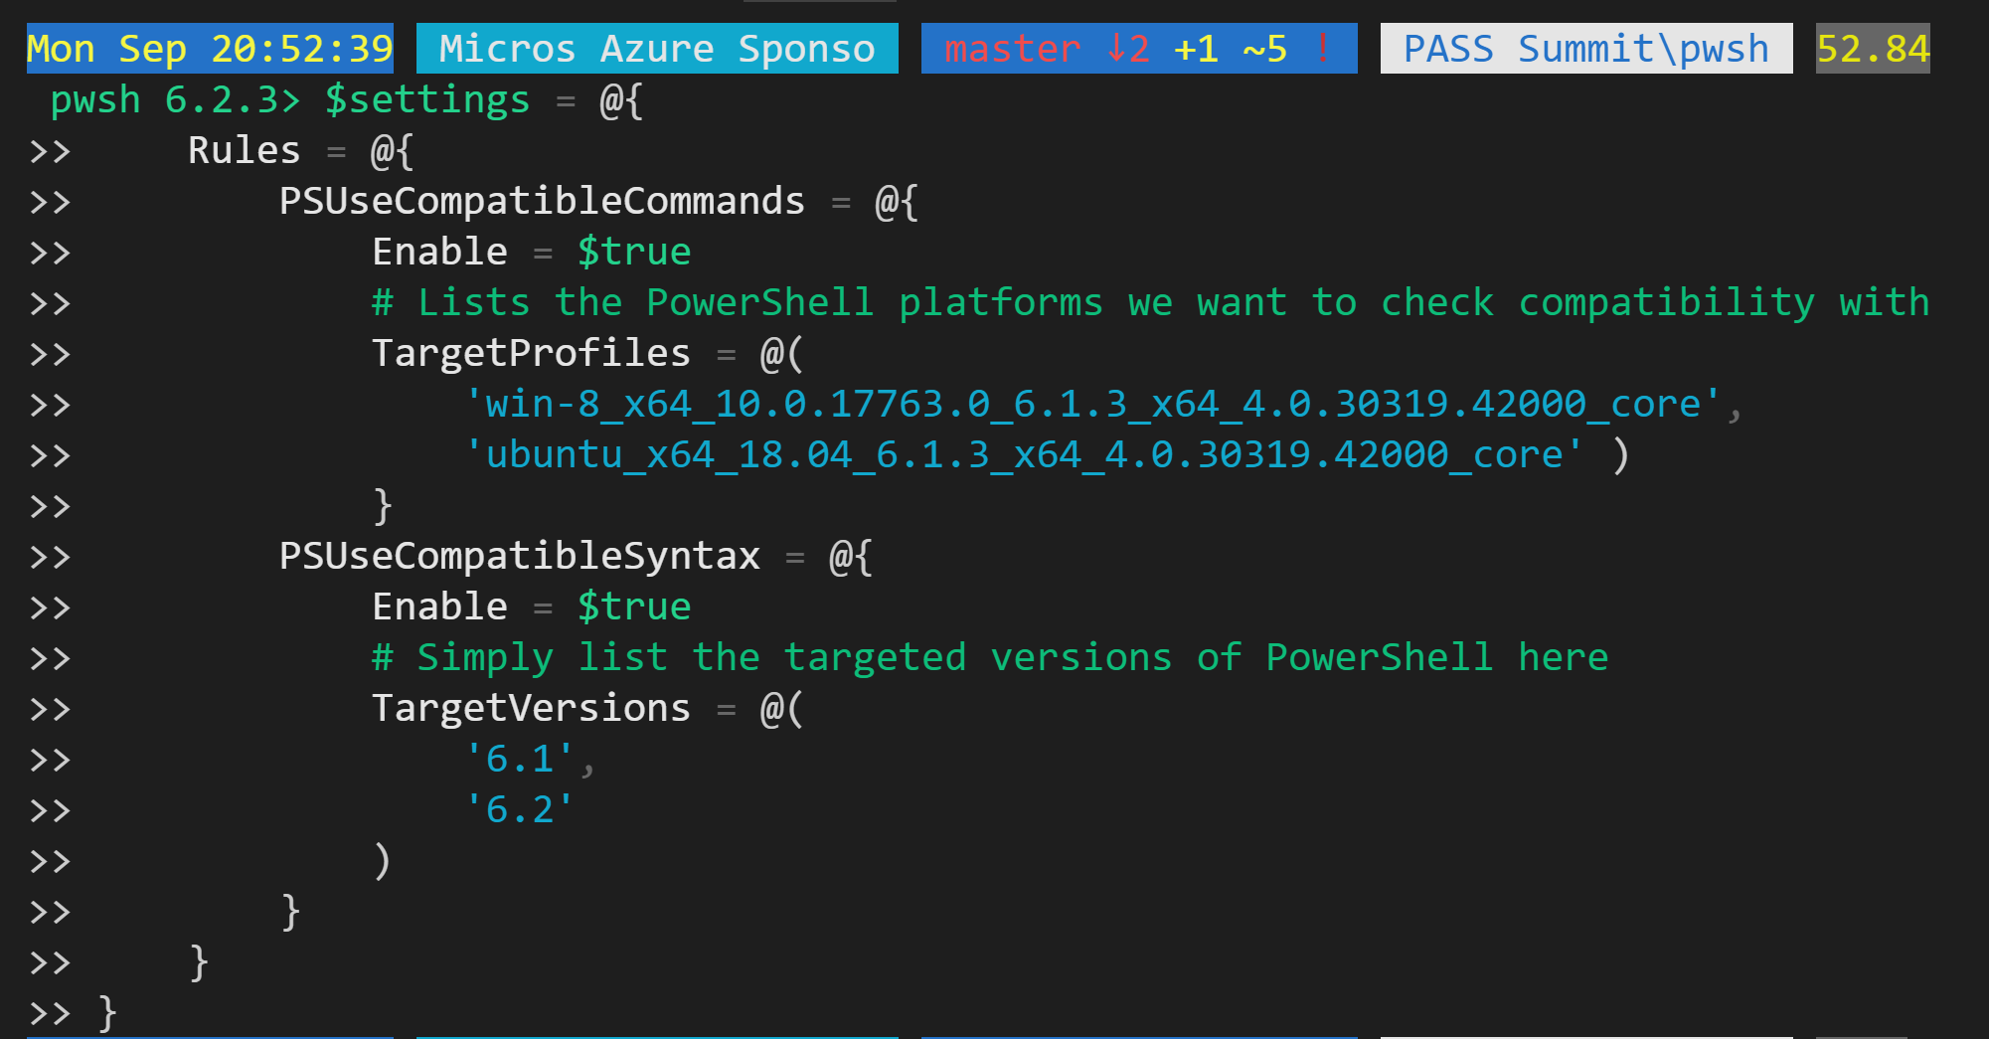
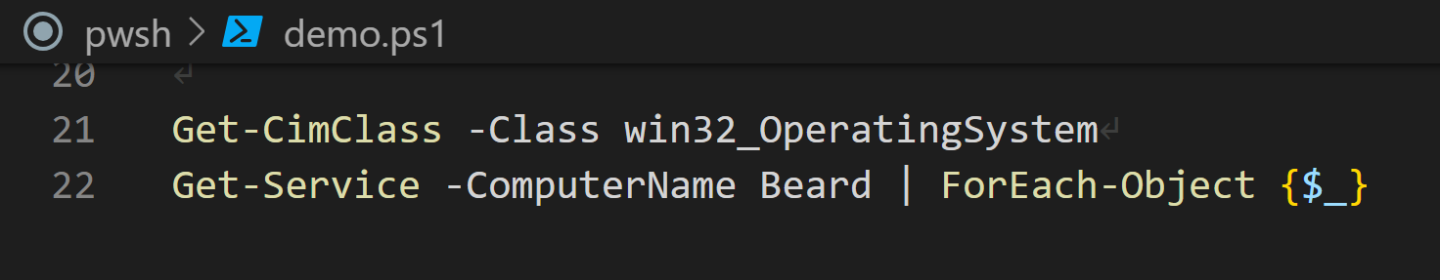
Checking for Core Compatability
Fixed the original problems in the script Notice there are no squiggles

Slide 59
Checking for Core Compatability
Create settings for script analyzer

Slide 60
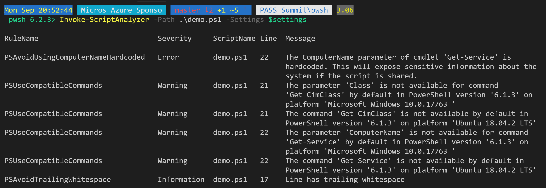
Checking for Core Compatability
Invoke-ScriptAnalyzer -Path .\demo.ps1 -Settings $settings

Slide 61
Checking for Core Compatability
Invoke-ScriptAnalyzer -Path .\demo.ps1 -Settings $settings

Slide 62
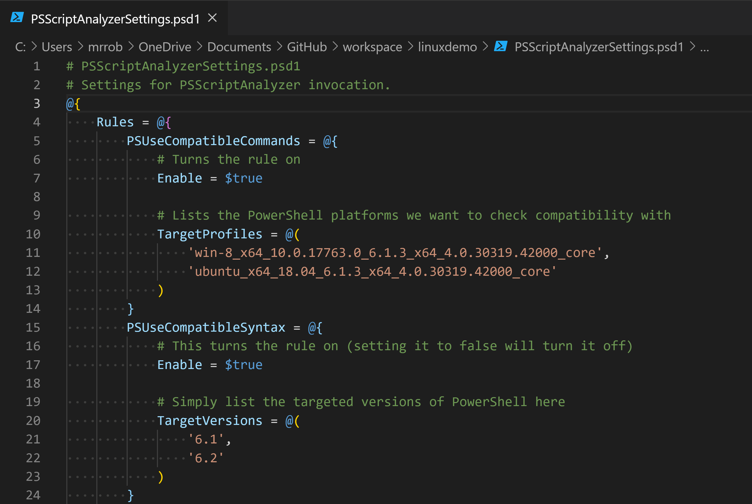
Set it automatically for VS Code
Save the settings as psd1 file

Slide 63
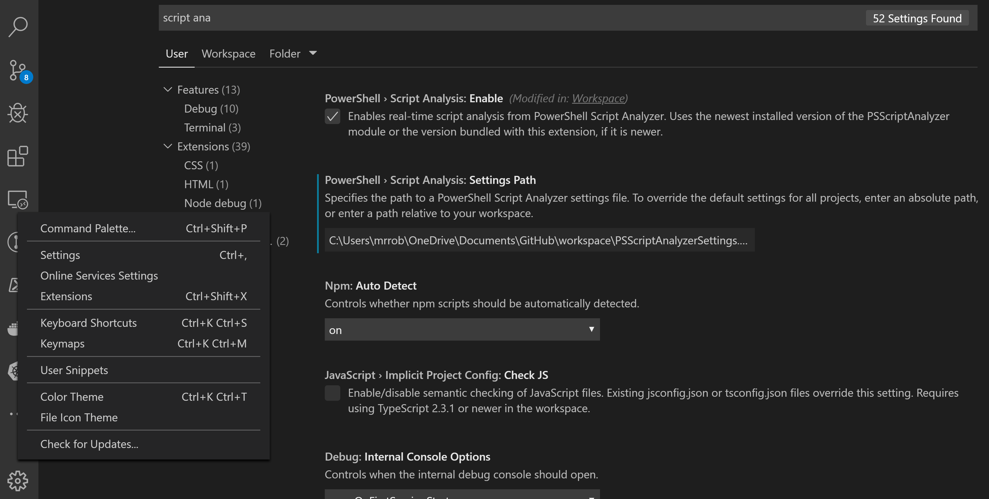
Set it automatically for VS Code

Slide 64
Set it automatically for VS Code

Slide 65
Set it automatically for VS Code

Slide 66
Set it automatically for VS Code

Slide 67
Set it automatically for VS Code

Slide 68
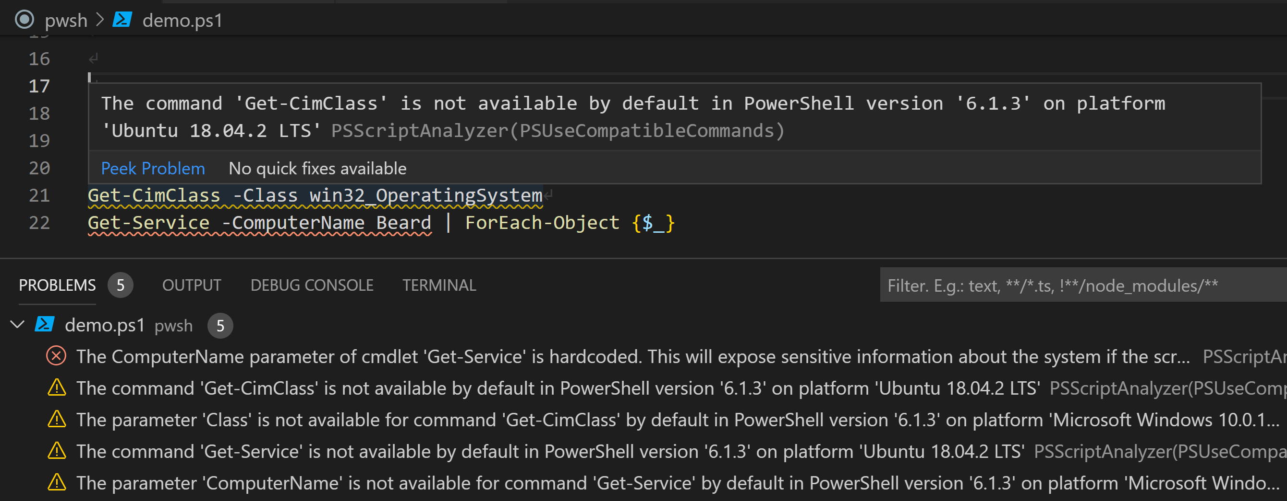
Set it automatically for VS Code
Built in compatibility squiggly goodness

Slide 70
Rob Sewell
@SQLDBAWithBeard
mrrobsewell@outlook.com
beard.media/book

